Slide 1
SUPPORT VECTOR MACHINE

Slide 2
What is Support Vector Machine?
Support Vector Machine (SVM) is a supervised machine learning algorithm which can be used for both classification or regression analysis.
However it is mostly used in classification problems.
In this algorithm we plot each data item as a point in n-dimensional space (where n is the number of features you have) with the value of each feature being the value of a particular coordinate.
Then we perform classification by finding the hyper-lane that differentiate the two classes very well.

Slide 3
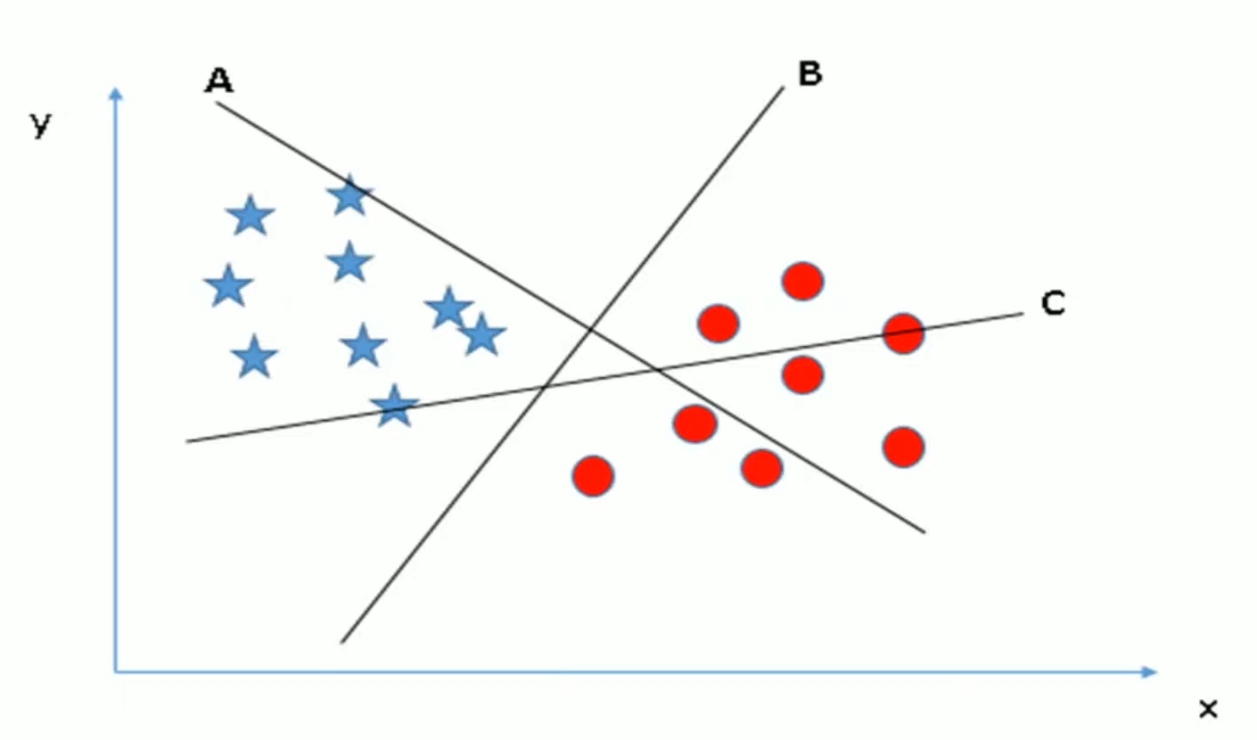
How does it work?

Slide 4
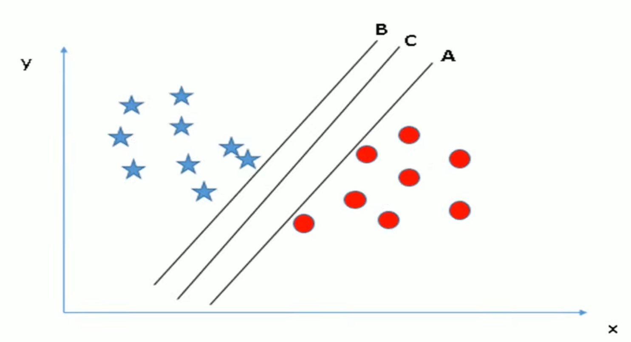
How does it work?

Slide 5
How does it work?
Thumb rule to identify the right hyper-plane
Select the hyper-plane that segregates the two classes better.
Maximizing the distances between nearest data point (either class) and the hyper-plane.
This distance is called the Margin

Slide 6
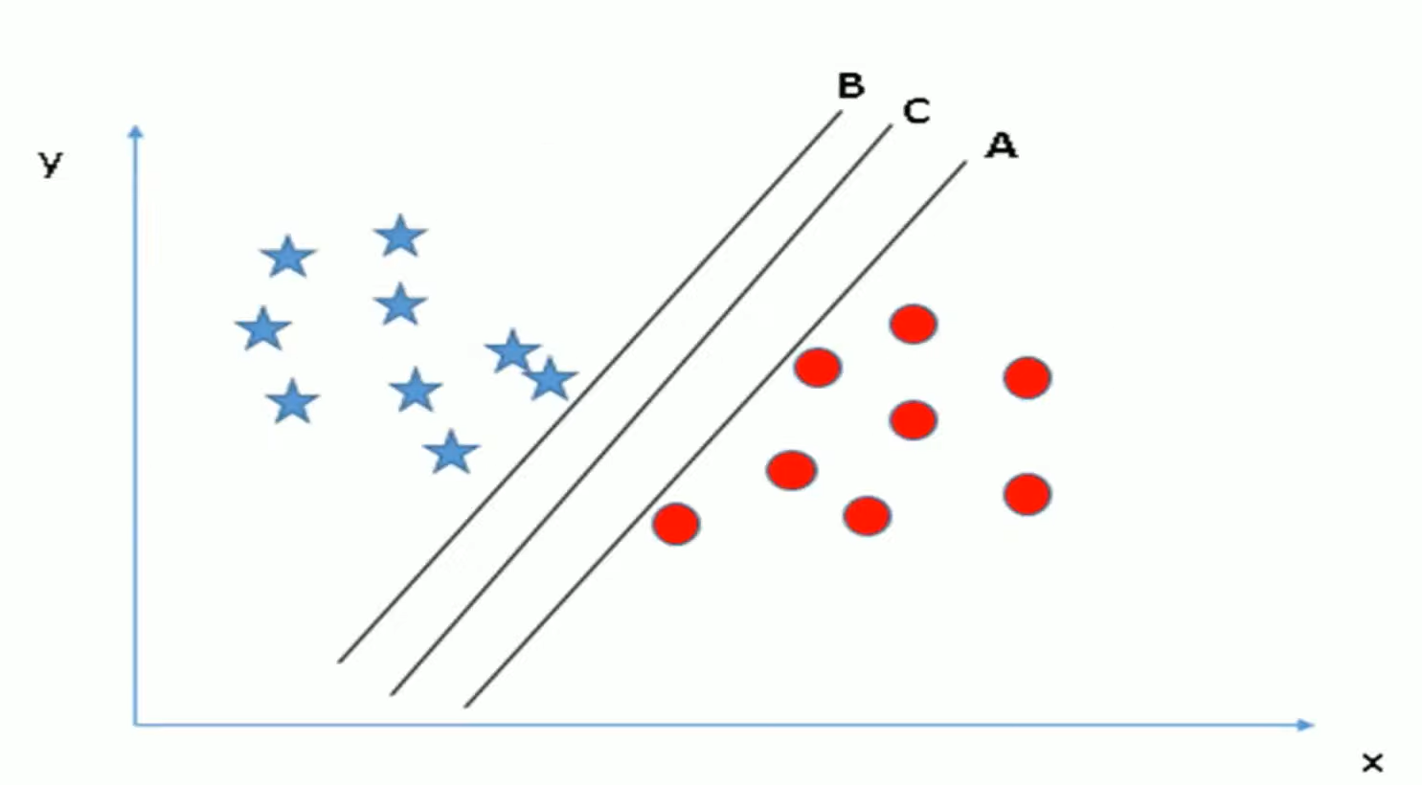
How does it work?

Slide 7
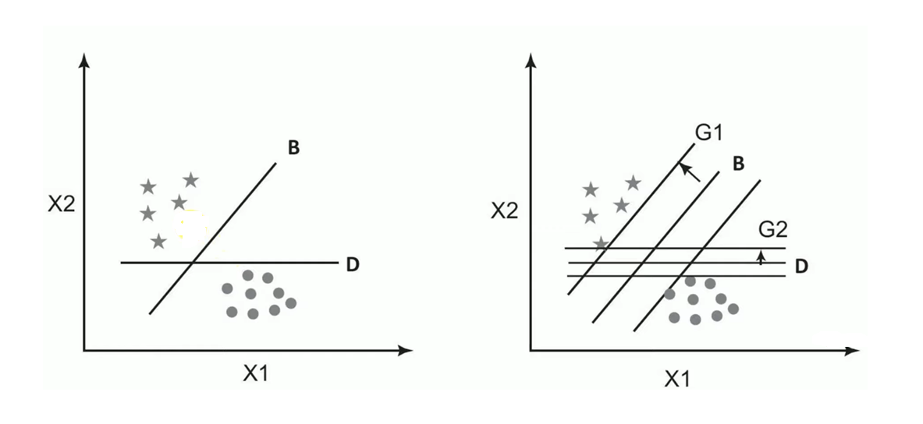
How does it work?

Slide 8
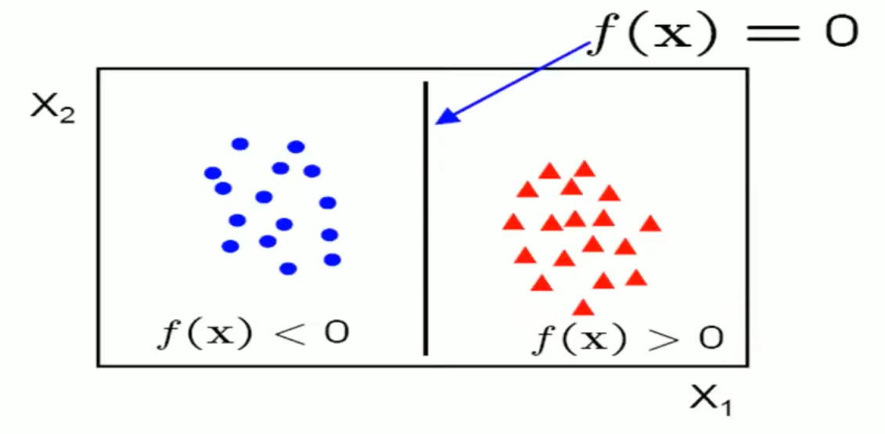
How does it work?
f(X) = W.X + b
W is the slope or normal to the line, X is the input vector and b is the bias or the intercept.
W is known as the weight vector.

Slide 9
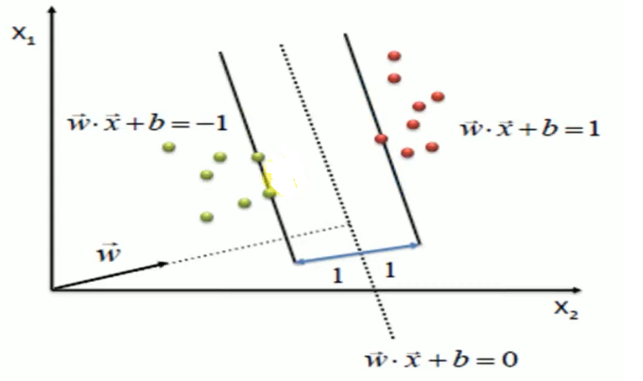
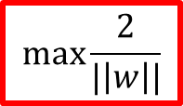


How does it work?
$$\max{\frac{2}{|\left|w\right||}}$$
s.t.
$$\left(w.x+b\right)≥1, ∀x of class 1$$
$$\left(w.x+b\right)≤−1, ∀x of class 2$$

Slide 10
Advantages of SVM
The main strength of SVM is that they work well even when the number of SVM features is much larger than the number of instances.
It can work on datasets with huge feature space, such is the case in spam filtering , where a large number of words are the potential signifiers of a message being spam.
Even when the optimal decision oundary is a nonlinear curve, the SVM transforms the variables to create new dimensions such that the representation of the classifier is a linear function of those transformed dimensions of data.
SVMs are conceptually easy to understand. They create an easy to understand linear classifier.
SVMs are now available with almost all data analytics toolsets.

Slide 11
Disadvantages of SVM
The SVM technique has two major constraints.
- it works well with real numbers, i.e, all the data points in all the dimensions must be defined by numeric values only.
- It works only with binary classification problems. One can make a series of cascaded SVMs to get around the constraint.
Training the SVMs is inefficient and time consuming process, when the data is large.
It does not work well when there is much noise in the data, and thus has to compute soft margins.
The SVMs will also not provide a probability estimate of classification, i.e, the confidence level for classifying an instance.

Slide 12
Applications of SVMs
Classification
Regression Anlysis
Pattern Recognition
Outliers detection
Relevance based applications

